Slide 1

Liver Disease Prediction

Slide 2
Data Description:
Dataset= from Kaggle
584 instances
11 attributes including the class attribute:
Attributes:
Age of the patient
Gender of the patient
Total Bilirubin
Direct Bilirubin
Alkaline Phosphatase
Alamine Aminotransferase
Aspartate Aminotransferase
Total Proteins
Albumin
Albumin and Globulin Ratio
Result (Class attribute)

Slide 3
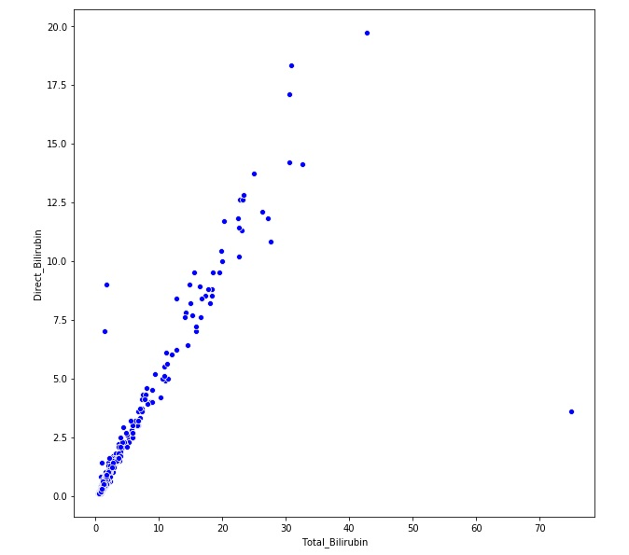
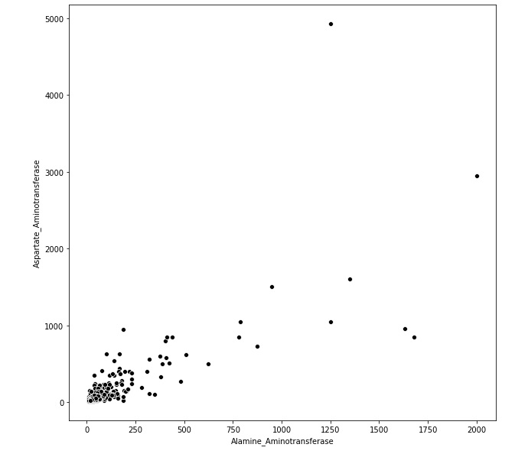
Basic analysis:
4 missing values in “Albumin_and_Globulin_Ratio”
The predicting attribute “Result” : 1 (416 instances with liver disease)
2 (167 instances with no liver disease)
Similar behavior found between some features like
Between Alamine Aminotransferase and
Aspartate Aminotransferase
between Total Bilirubin and
Direct Bilirubin

Slide 4
Pre-processing:
Filled the 4 empty cells with the mean value of the column
Divided the dataset into: 1. Training and 2.Test(20% of the whole)
Result values (from numerical to catagorical): changed 1 to Yes
changed 2 to no
Removed Total Bilirubin
Removed Aspartate Aminotransferase
Removed Gender

Slide 5
Results(using Logistic Regresssion):
Raw data: Train accuracy= 72.3%
Test accuracy= 72.6%
After removing 3 features:: Train accuracy= 72.9%
Test accuracy= 73.5%

Slide 6
Works for Final Outcome:
Cross validation
Using SVM
Using Random forest
More pre-processing

Slide 7
Thank you.

